Slide 1



Predicting Severe Asthma Exacerbations
A Genome-Wide Association Study using Random Forests Classifiers
Mousheng Xu, PhD
Dec 2025 | GTIIT’s 3rd International Symposium Presentation
Notes:
Good morning/afternoon, everyone. I am Mousheng Xu.
First and foremost, I would like to express my sincere gratitude to Dr. Dganit for inviting me to this symposium and giving me the opportunity to speak today. It is truly an honor and a pleasure to be standing here.
Thank you all for taking time out of your busy schedules to join us.
Today, I will be presenting our research on "Predicting Severe Asthma Exacerbations", a side project I conducted while I was working on y Ph.D. dissertation at Harvard Medical School.

Slide 2
Self Introduction
Mousheng Xu, PhD
Head of Biosciences, A Private Company In Singapore
•
Academic Foundation:
B.S. in Genetics (Wuhan University)
M.S. in Biochemistry & Molecular Biology, M.S. in Computer Science (University of Kansas)
PhD in Bioinformatics (Boston University; Harvard Medical School)
Postdoc in Cancer Genetic Epidemiology (Harvard T.H. Chan School of Public Health).
•
20+ Years Experience: Software development, computational biology, statistical genetics, and machine learning.
•
Key Achievements:
○
The Encyclopedia of DNA Elements (ENCODE)
Million Veteran Program (MVP)
○
○
Founded Hubei Vidagen (Genetic Testing)
○
Scientific Breakthrough Of the Year (ATS 2009)
Notes:
Please allow me to give a brief self introduction In terms of education, I have a … In terms of work experience, I have more than 20 years of experience in software development, bioinformatics or computational biology, statistical genetics, and machine learning For things I feel proud of, I worked on … One of my major early contributions was to the ENCODE project.
ENCODE is an international consortium aimed at identifying all functional elements in the human genome. Million Veteran Program, which is one of the world’s largest genomic and clinical databases, combining genetic data with electronic health records from over a million participants

Slide 3


The Clinical Challenge：Childhood Severe Asthma Exacerbations
Definition
Severe Asthma Exacerbations: emergency room visit or a hospitalization for asthma symptoms.
Prognostic Significance
Earlier therapeutic interventions.
The Clinical Challenge
Prediction with clinical traits is not good enough
Genomic information might be helpful for prediction
Notes:
Today The core clinical problem we addressed is prediction.
Severe asthma exacerbations—defined as events requiring emergency room visits or hospitalization—are dangerous, costly, and difficult to foresee. The ability to predict this risk early using genetic markers would have direct prognostic significance, forming the basis for earlier and more effective therapeutic interventions.

Slide 4






The Problem: ”Small N, Large P" Problem
Sample Size (N)
Predictors (P)
Standard Method
127 cases
290 controls
417 total
> 550,000
Logistic Regression
Single Nucleotide Polymorphisms (SNPs) + Clinical Traits
Struggles when predictors (P) vastly outnumber samples (N)
Problem: overfitting
Notes:
Our analysis faced a classic but severe statistical hurdle: "Small N, Large P."
We had a high-quality dataset of 417 subjects (Small N), but we had to screen over 550,000 genetic and clinical predictors (Large P).
Standard methods like Logistic Regression fail in this scenario because they cannot handle such high dimensionality without overfitting. We needed a machine learning tool specifically designed for this scale.

Slide 5

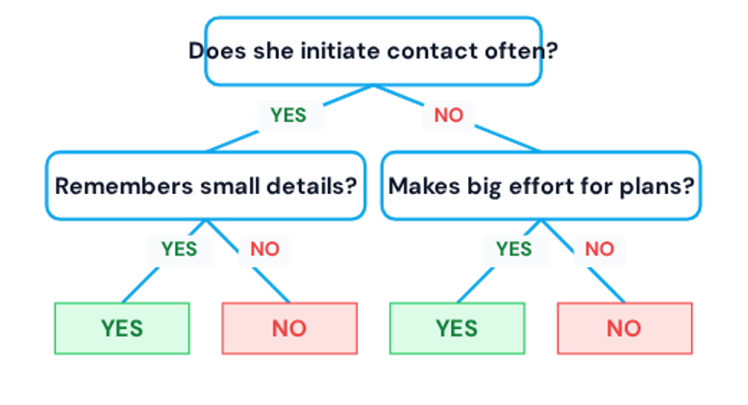


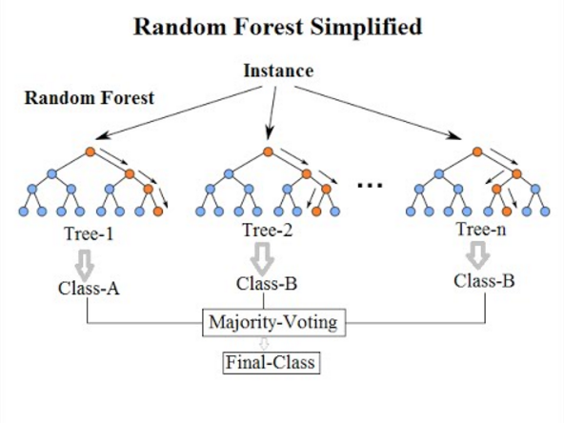
Our Solution: Random Forests
Leveraging ensemble power for robust predictive modeling.
Key Concepts of Random Forests
A decision tree predicts outcomes by splitting data based on feature values.
An ensemble of many decision trees forms a "forest".
Each tree uses random samples of the data and considers only random features at each split, enhancing diversity.
Voting Mechanism: The model aggregates predictions by taking the votes from each decision tree to determine the final outcome.
Handles nonlinear, high-dimensional data effectively, crucial for complex datasets.
It is known to be relatively resistant to overfitting
Notes:
Our solution was the Random Forest classifier.
As the diagram on the left shows, a single Decision Tree can be unstable. However, the Random Forest (on the right) uses an ensemble of hundreds of trees.
Each tree is trained on a random subset of data and votes on the outcome. We then use a "Majority Vote" mechanism to determine the final prediction. This "wisdom of the crowds" approach drastically increases stability and accuracy compared to any single model.

Slide 6
Key Terminology：SNP
Single Nucleotide Polymorphism
A one-letter difference (A/C/G/T) on DNA
May influence traits or disease risks
Notes:
Briefly, here are the key terms for this analysis:
SNP (Single Nucleotide Polymorphism): The single-letter genetic variations we used as predictors.
Importance Score: The metric Random Forest uses to rank predictors by their predictive power.
AUC (Area Under the Curve): Our measure of success. 0.5 is a random guess; 1.0 is perfect prediction. We aim to maximize this.

Slide 7
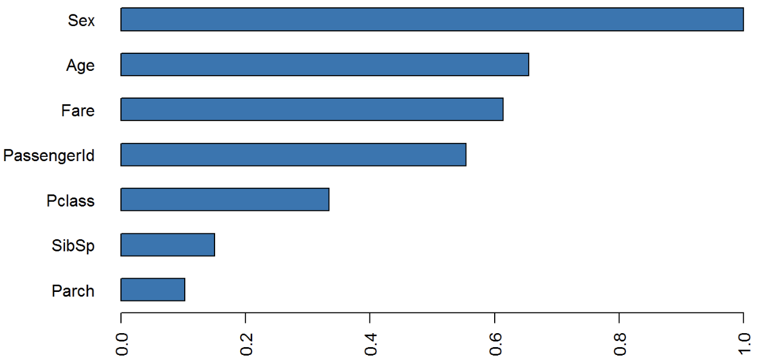
Key Terminology: RF Importance Score
Random Forest predictive power: contribution to the predictive accuracy
The higher, the more contribution
Notes:
During model building, RF uses a method to estimate how importance a predictor (or a feature) is, and assign a importance score to each predictor. The higher the importance score, the more contribution the predictor makes to the prediction.

Slide 8
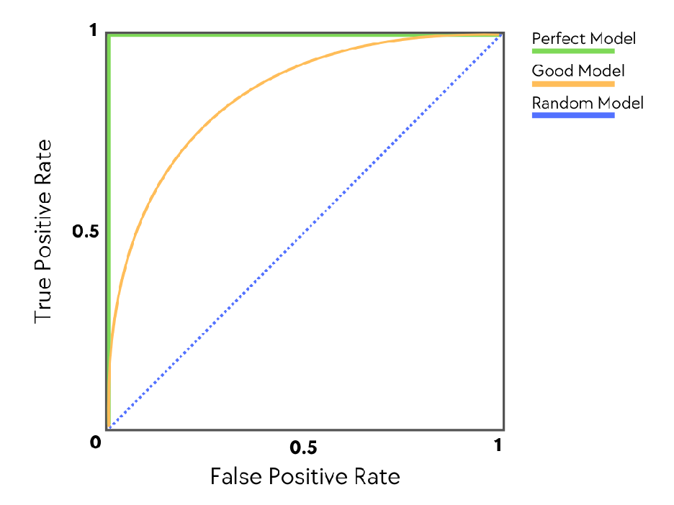
Key Terminology: AUC
Area Under the (ROC) Curve
A performance metric ranging from 0 to 1
Measures the ability to distinguish between classes
0.5 is random guessing
1.0 is perfect prediction
Receiver-Operating Characteristic (ROC) curve

Slide 9
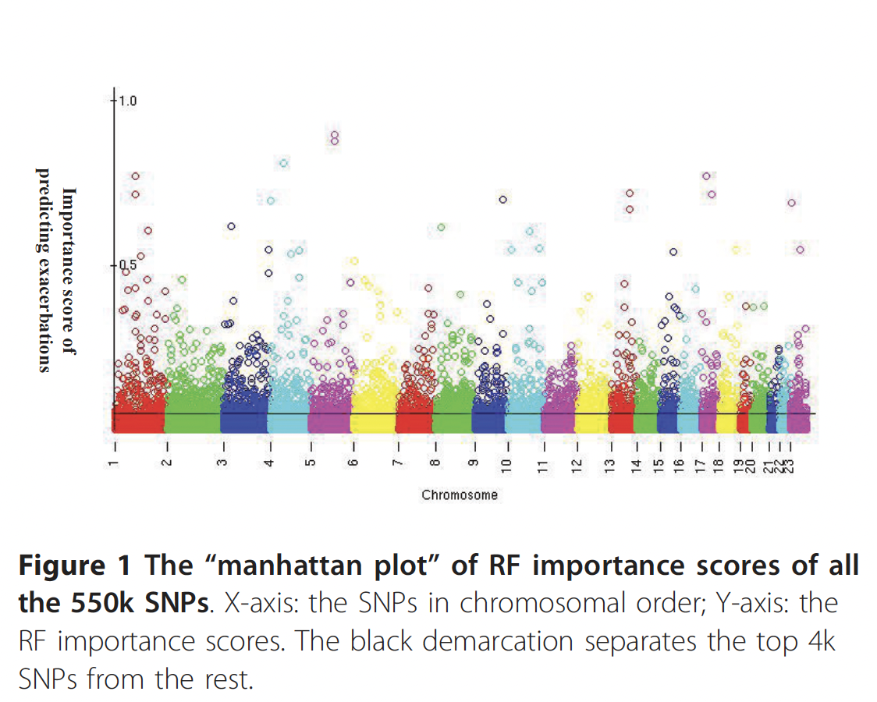
Methodology: Feature (SNP) Selection
Step 1: Initial Screen
Step 2: Ranking
Step 3: Prediction
RF
RF
RF
4k SNPs
4k SNPs
…
4k SNPs
Top 4k SNPs Importance
Score
Reranked 4k SNPs Importance
Score
RF
RF
Build final models using Top N SNPs (10, 40, 160, 320) + 4 Clinical Traits.
Notes:
We developed a three-step filtering pipeline to find the true genetic signal among the noise:
Initial Screen: We scored all 550,000 SNPs using the Random Forest Importance metric.
Ranking: We isolated the top 4,000 signals and re-ran the model to stabilize the rankings.
Prediction: Finally, we built models using increasing subsets of these top SNPs (Top 10, 40, 160, etc.) combined with clinical traits to find the peak performance.

Slide 10
The RF Importance Landscape
Notes:
Unlike a traditional GWAS Manhattan plot which shows -log(p-values), this plot visualizes Random Forest Importance Scores across the genome.
The "peaks" represent SNPs that contribute most significantly to classifying a patient as an "Exacerbator" vs. “Non-Exacerbator".
We identified a clear signal distinguishing the top predictive SNPs from the genomic background noise.

Slide 11
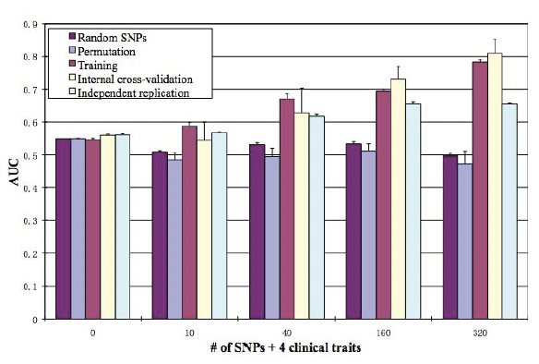
Predictive Power
Area Under the Curve (AUC) in Independent Replication Cohort
Adding genetic markers significantly improved prediction over clinical history alone.
The model plateaued at 160 SNPs
Permutation Testing: Confirmed results were not due to chance.
Independent Replication: The model was tested on a separate cohort of 164 subjects, maintaining an AUC of 0.66.
Notes:
Here is the key result.
The gray bar shows the model using only clinical traits—it achieved an AUC of 0.54, which is barely better than random.
However, as we added the top genetic markers (the blue and green bars), the accuracy climbed significantly. We reached a peak AUC of 0.66 using the Top 160 SNPs. This proves that the genetic signature provides predictive value that clinical history alone cannot capture. Internal cross-validation: 9 fold cross-validation. “Internal cross-validation: the AUC of the model built with 90% of the randomly selected Stage 1 samples predicting on the rest (10%) of the Stage 1 samples."

Slide 12
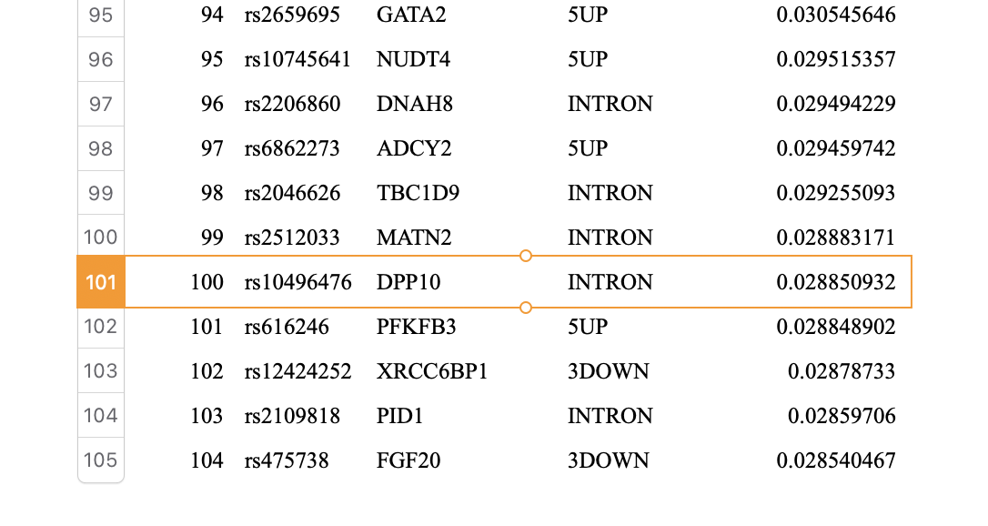
Top Genes
The 160 SNPs are in or near to 140 genes
One SNP (rs10496476) is located within the intron of gene DPP10, which has been shown to be associated with asthma in multiple populations, based on a recent review
Most genes are novel

Slide 13




Significance of the Research
Clinical Utility
Methodological Innovation
Biological Insight
By identifying specific genetic markers (SNPs) linked to exacerbation risk, we move closer to Personalized Medicine. This enables earlier therapeutic interventions for high-risk children, potentially reducing hospitalizations.
We successfully demonstrated that Random Forests can handle the "Small N, Large P" problem in genomics. This validated a new approach for integrating massive genetic datasets with clinical variables without overfitting.
The model identified novel genetic targets (like DPP10) by capturing non-linear gene-gene interactions that traditional linear models miss, opening new avenues for understanding asthma pathology.

Slide 14

Recognition
ATS 2009: Featured at the "Scientific Breakthroughs of the Year" symposium.
Impact: Categorized as "Highly Accessed" (1,120 accesses 4 months after publication) by BMC Medical Genetics, influencing future ML-GWAS integration studies.
Notes:
In machine learning, validation is everything. We ensured our results were robust through:
Permutation Testing: Proving our results were not due to chance.
Independent Replication: Most importantly, we tested the model on a completely separate cohort of 164 subjects, and the AUC held steady at 0.66.
This rigorous validation is why the work was recognized as a "Scientific Breakthrough of the Year" by the American Thoracic Society (ATS).

Slide 15
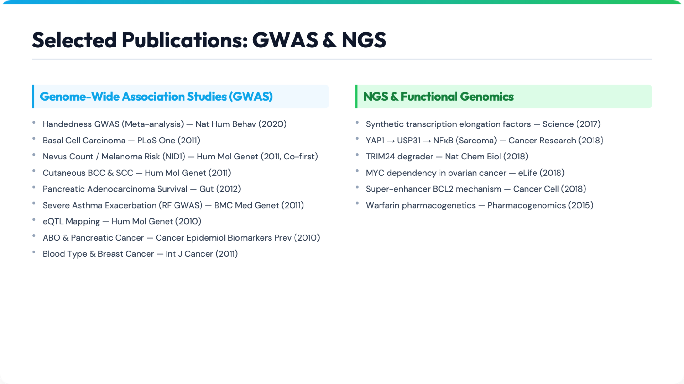
Notes:
My research impact extends well beyond this study.
I have published extensively in both Genome-Wide Association Studies (GWAS) and Next-Generation Sequencing (NGS). My work includes high-impact papers in journals like Science and Nature Cell Biology, covering topics ranging from Melanoma risk and Pancreatic cancer survival to the fundamental mechanisms of transcription.

Slide 16
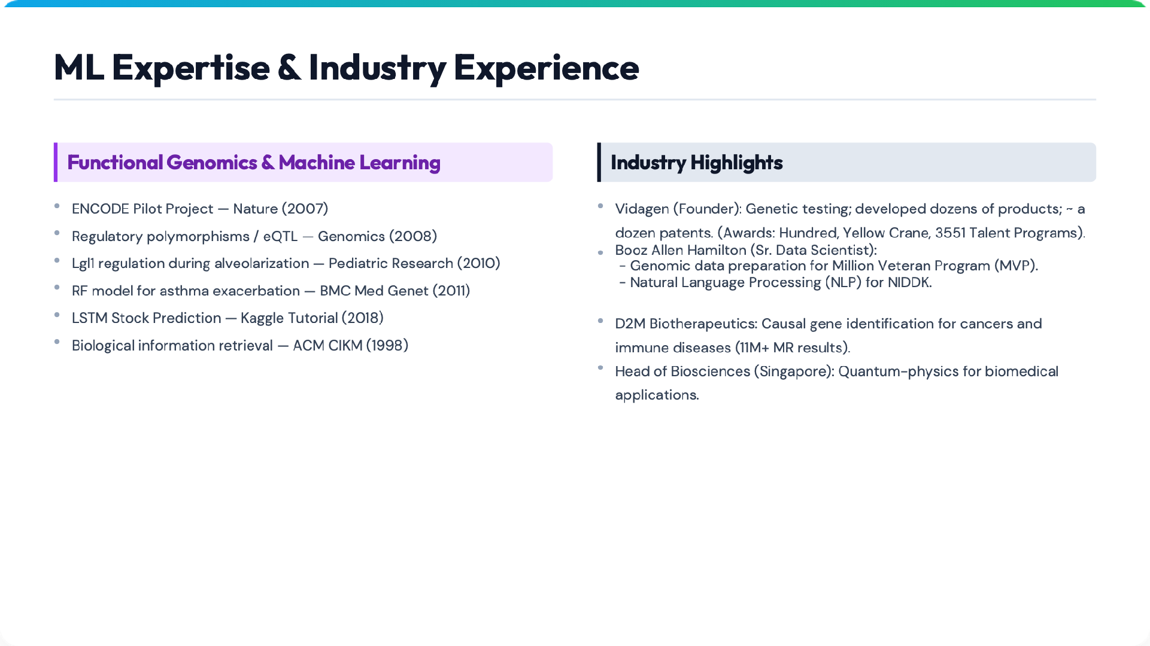
Notes:
I also bring strong industry and technical depth.
Beyond Random Forests, I have deployed Natural Language Processing (NLP) models for NIH datasets and LSTM deep learning models for time-series prediction.
As a founder of Vidagen and a lead at D2M and Booz Allen, I have a proven track record of translating these theoretical models into functional, large-scale genomic pipelines in the private sector.

Slide 17
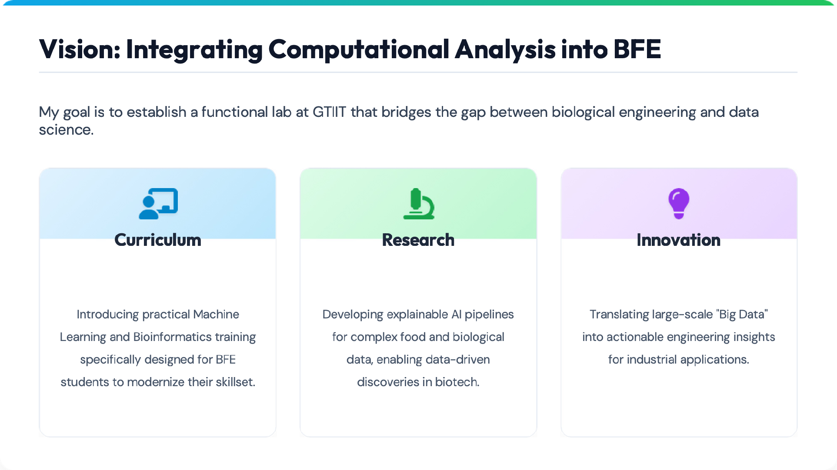
Mousheng Xu, PhD
moushengxu@gmail.com
Notes:
I view this opportunity as a chance to drive significant strategic growth. If I were selected for this role, my vision would be to establish a lab that bridges biology and data science.
Curriculum: I will fill the skills gap by teaching practical Machine Learning and Bioinformatics to students.
Research: We will apply explainable AI to complex food and biological data.
Innovation: We will translate large-scale omics data into actionable engineering insights for industrial applications.

Slide 18
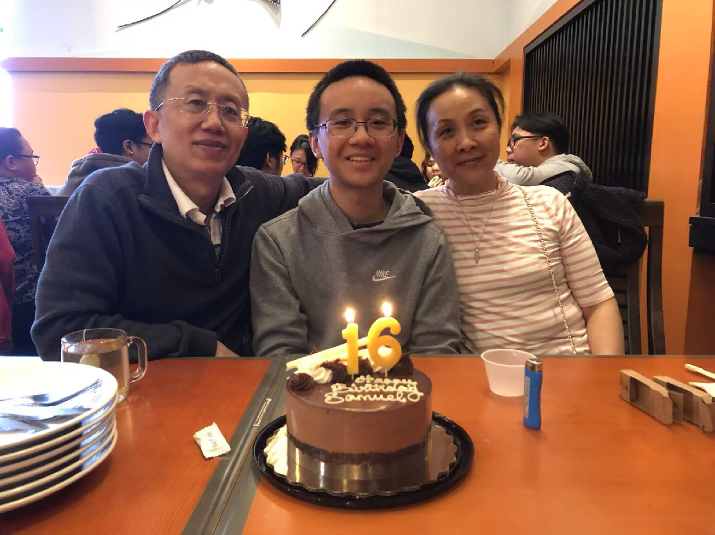
Family

Slide 19

Thank You
Questions & Discussion
Mousheng Xu, PhD
moushengxu@gmail.com
Notes:
Thank you very much for your time.
I would be delighted to discuss how my expertise can contribute to the future of the BFE Department. I welcome your questions.

Slide 20
Backup Slides

Slide 21
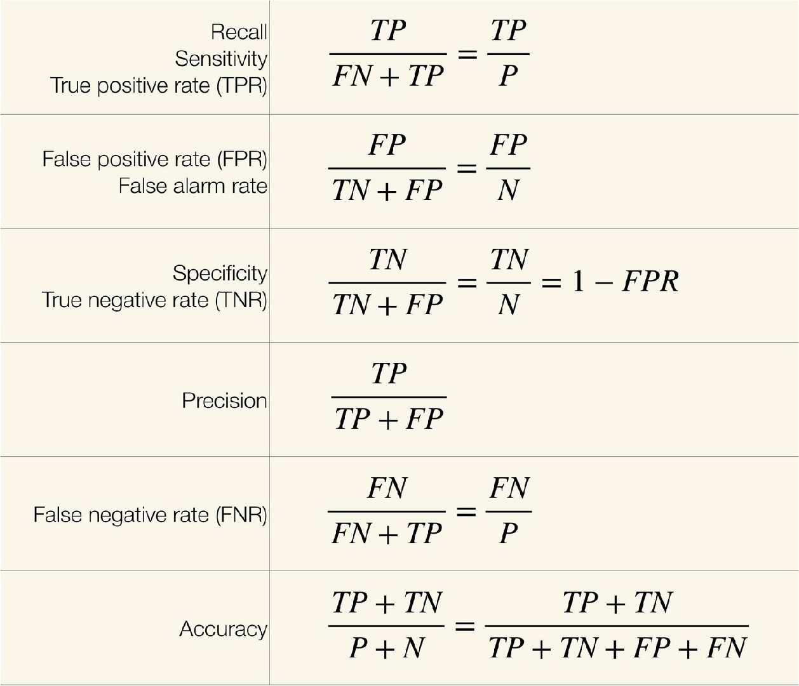
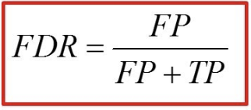
Receiver-operating characteristic curve
(ROC)

Slide 22
